Slide 1







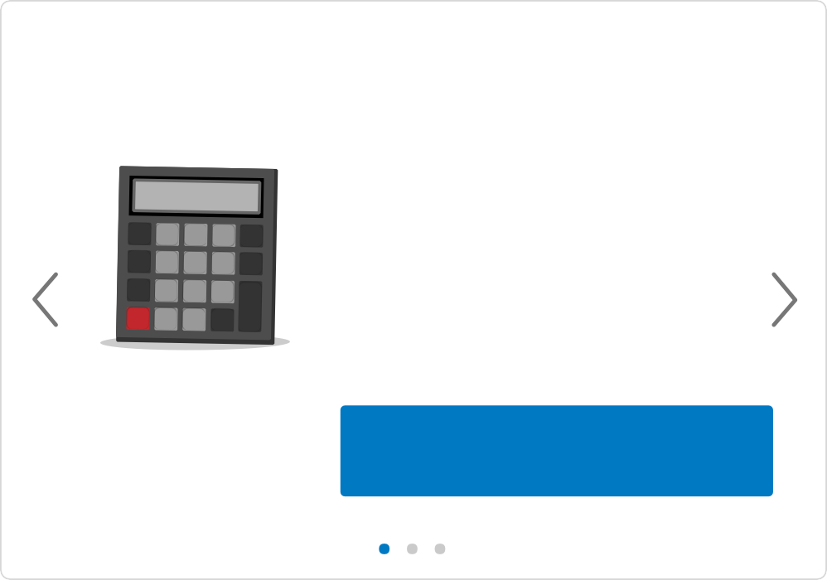



Welcome User's Name | Account Settings | Logout
Search
Get Help
Home
My Account
Claims
Prescriptions
Find a Doctor
Health & Wellness
Resources
Subscriber
S User Name
Go Paperless | View Statements
Spending
In Network
Frequently Asked Questions
Out of Network
All Members
Plan Name
Excellus Standard Health Plan
Subscriber ID
XXX 000000000
Family Deductible
Family Out-of-Pocket
Active Plan Members
Subscriber Name Dependent Name Dependent Name
Plan Year Effective Date
01/01
$975.38
met
$2,500 max
$975.38
met
$4,000 max
Plan Start Date
01/01/2017
Remaining Deductible
$1,524.62
Remaining Out-of-Pocket
$2,649.30
Pay Your Bill Now
Member Cards
Claims
My Coverage
In Network
Search for Benefit
Out of Network
Once you meet your deductible limit, you'll only contribute copay(s) or coinsurance
Office Visit - PCP
Office Visit - Specialist
Urgent Care
Emergency Room
Prescription Drugs
50% Coinsurance
50% Coinsurance
50% Coinsurance
50% Coinsurance
Details
View All Benefits
Get Rewards
Treatment cost calculator
With HealthyRewards ®you can
earn up to $1,000 per family each year for doing healthy stuff that fits into your day.
÷
7
8
9
Estimate your out-of-pocket
costs for a wide variety of treatments, procedures and visits.
%
4
5
6
x
√
1
2
3
–
AC
0
.
=
+
Learn how to join
Start Earning
Estimate Costs
Let Us Help
Contact Us Insurance FAQs Glossary
Medicare Seminars Caregiver Support Fraud & Abuse
Get to Know Us
About Us News
Company Policies Careers
Health Blog Community Events
Member Benefits
View Plan Benefits HealthyRewards® Blue365
Exercise Rewards
Manage Prescription Costs Healthwise Knowledgebase
Member Tools
Member ID Card Go Paperless Print Forms
Estimate Treatment Costs View Claims
View Plan Coverage
Copyright © 2016, Excellus BlueCross BlueShield, a nonprofit independent licensee of the Blue Cross Blue Shield Association. All rights reserved.
Follow us on
Terms of Use | Web Privacy Policy | Browser Support

Slide 2



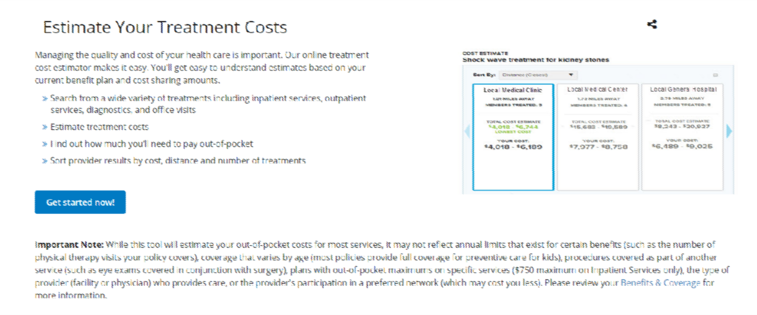


Welcome User's Name | Account Settings | Logout
Search
Get Help
Home My Account Claims Prescriptions Find a Doctor Health & Wellness Resources
Home
My Account
Claims
Prescriptions
Find a Doctor
Health & Wellness
Resources
Estimate Your Treatment Costs
Helpful Resources
Provider Manuals Policies
Prior Authorization Forms Print Forms
Clinical Resources Patient Education Tools
Get to Know Us
About Us News
Company Policies Careers
Join Our Network Quality Improvement
Let Us Help
Contact Us Glossary Staff Training
Give Us Feedback Fraud & Abuse
Access Provider Tools
View Eligibility & Benefits Check Claims
Clear Coverage Tool Update Practice Information Fee Schedules
Check Referrals
Language Assistance and Non-Discrimination Notice
Español | 中文 | Pусский | Kreyòl Ayisyen | 한국어 | Italiano | שידיא | বাংলা | Polski | ﺔﻴﺑﺮﻌﻟا | Français | ودرا | Tagalog | ελληνικά | shqiptar
Copyright © 2017, Excellus BlueCross BlueShield, a nonprofit independent licensee of the Blue Cross Blue Shield Association. All rights reserved.
Follow us on
Terms of Use | Web Privacy Policy | Browser Support

Slide 3









Welcome User's Name | Account Settings | Logout
Search
Get Help
Home My Account Claims Prescriptions Find a Doctor Health & Wellness Resources
Home
My Account
Claims
Prescriptions
Find a Doctor
Health & Wellness
Resources
Home > Plan Overview
PLAN SUMMARY
Member
Subscriber
Member Profiles
Subscriber Name Dependent Name Dependent Name
Plan
Excellus Health Plan
Subscriber ID
XXX 000000000
Group Policy & Plan
00000000 - Group Policy
Member Effective Since
01/01/2016
Plan Year Effective Date
01/01
manage my plan
Benefit Details
MANAGE PLAN
MANAGE ACCOUNT
Change or Update Policy
Change Address & Phone Enroll in a New Policy
Statements & Documents
Manage My Privacy Referrals & Authorizations
Change My Doctor
Helpful Resources
Provider Manuals Policies
Prior Authorization Forms Print Forms
Clinical Resources Patient Education Tools
Get to Know Us
About Us News
Company Policies Careers
Join Our Network Quality Improvement
Let Us Help
Contact Us Glossary Staff Training
Give Us Feedback Fraud & Abuse
Access Provider Tools
View Eligibility & Benefits Check Claims
Clear Coverage Tool Update Practice Information Fee Schedules
Check Referrals
View the Excellus BCBS Service Area
Language Assistance and Non-Discrimination Notice
Español | 中文 | Pусский | Kreyòl Ayisyen | 한국어 | Italiano | שידיא | বাংলা | Polski | ﺔﻴﺑﺮﻌﻟا | Français | ودرا | Tagalog | ελληνικά | shqiptar
Copyright © 2017, Excellus BlueCross BlueShield, a nonprofit independent licensee of the Blue Cross Blue Shield Association. All rights reserved.
Follow us on
Terms of Use | Web Privacy Policy | Browser Support

Slide 4










Welcome User's Name | Account Settings | Logout
Search
Get Help
Home My Account Claims Prescriptions Find a Doctor Health & Wellness Resources
Home
My Account
Claims
Prescriptions
Find a Doctor
Health & Wellness
Resources
Home > Medical Claims History
Search Medical Claims
From To
01/01/2017 06/29/2017
Member
All Members
Search
8 Claim Results
2017
01/01/2017 - 06/29/2017
Jun 22
In Process
Subscriber Visited
Doctor Name
Your Responsibility
$122.57 estimate
May 31
Paid
Dependent Visited
Doctor Name
Your Responsibility
$68.72
May 17
Paid
Dependent Visited
Doctor Name
Your Responsibility
$115.22
Apr 26
Paid
Subscriber Visited
Doctor Name
Your Responsibility
$100.07
Apr 4
Paid
Dependent Visited
Doctor Name
Your Responsibility
$50.00
Mar 22
Denied
Subscriber Visited
Doctor Name
Your Responsibility
$0.00
Mar 12
Paid
Subscriber Visited
Doctor Name
Your Responsibility
$88.55
Feb 2
Paid
Dependent Visited
Location or Service Facility
Your Responsibility
$108.07
Helpful Resources
Provider Manuals Policies
Prior Authorization Forms Print Forms
Clinical Resources Patient Education Tools
Get to Know Us
About Us News
Company Policies Careers
Join Our Network Quality Improvement
Let Us Help
Contact Us Glossary Staff Training
Give Us Feedback Fraud & Abuse
Access Provider Tools
View Eligibility & Benefits Check Claims
Clear Coverage Tool Update Practice Information Fee Schedules
Check Referrals
View the Excellus BCBS Service Area
Language Assistance and Non-Discrimination Notice
Español | 中文 | Pусский | Kreyòl Ayisyen | 한국어 | Italiano | שידיא | বাংলা | Polski | ﺔﻴﺑﺮﻌﻟا | Français | ودرا | Tagalog | ελληνικά | shqiptar
Copyright © 2017, Excellus BlueCross BlueShield, a nonprofit independent licensee of the Blue Cross Blue Shield Association. All rights reserved.
Follow us on
Terms of Use | Web Privacy Policy | Browser Support

Slide 5

Welcome User's Name | Account Settings | Logout
Search
Get Help
Home My Account Claims Prescriptions Find a Doctor Health & Wellness Resources
Home
My Account
Claims
Prescriptions
Find a Doctor
Health & Wellness
Resources
Home > Medical Claims History > Claim Detail
Medical Claim Number
E07751081000
Claim Summary
Total provider charges for this claim
$122.57
Write of Review of Your Care
Under agreements with your provider,
Health Plan will pay
$0.00
$122.57 estimate
Dispute Claim
Your Responsibility
Description
Claims for services on 06/22/2016
Provider
First Name, Last Name MD
Paid on n/a
Patient Username
Status
In Process
Benefit Plan Benefit Type Name
Claim Items
This claims has 2 item(s)
How to Read a Claim
Description of Service | Date of Service(s) | Provider Charged | Allowed | Other Insurance | Paid | Your Responsibility |  |  |  | Remarks
 |  |  |  |  |  | Not Covered | Deductible | Copay | Coinsurance
Office Visit | 06/22/2016 - 06/22/2016 | $75.00 | $75.00 | $0.00 | $0.00 | $0.00 | $75.00 | $0.00 | $0.00 | N/A
Lab Results | 06/22/2016 - 06/22/2016 | $47.57 | $47.57 | $0.00 | $0.00 | $0.00 | $47.57 | $0.00 | $0.00 | L05
 | Totals: | $122.57 | $122.57 | $0.00 | $0.00 | $0.00 | $122.57 | $0.00 | $0.00
Back to Search Results
Helpful Resources
Provider Manuals Policies
Prior Authorization Forms Print Forms
Clinical Resources Patient Education Tools
Get to Know Us
About Us News
Company Policies Careers
Join Our Network Quality Improvement
Let Us Help
Contact Us Glossary Staff Training
Give Us Feedback Fraud & Abuse
Access Provider Tools
View Eligibility & Benefits Check Claims
Clear Coverage Tool Update Practice Information Fee Schedules
Check Referrals
View the Excellus BCBS Service Area
Language Assistance and Non-Discrimination Notice
Español | 中文 | Pусский | Kreyòl Ayisyen | 한국어 | Italiano | שידיא | বাংলা | Polski | ﺔﻴﺑﺮﻌﻟا | Français | ودرا | Tagalog | ελληνικά | shqiptar
Copyright © 2017, Excellus BlueCross BlueShield, a nonprofit independent licensee of the Blue Cross Blue Shield Association. All rights reserved.
Follow us on
Terms of Use | Web Privacy Policy | Browser Support

Slide 6




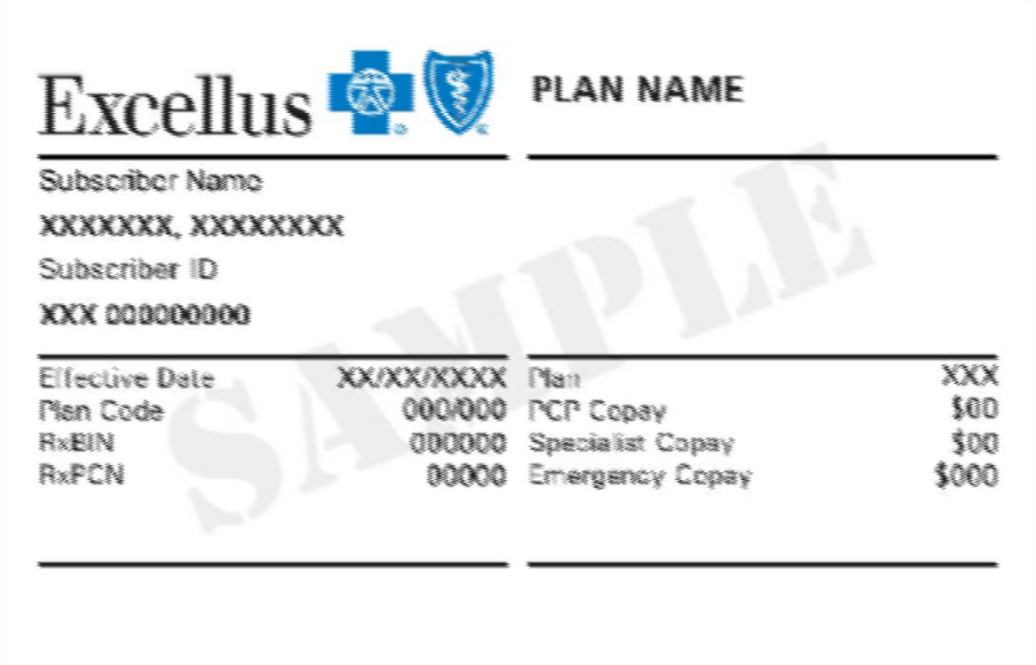


Welcome User's Name | Account Settings | Logout
Search
Get Help
Home My Account Claims Prescriptions Find a Doctor Health & Wellness Resources
Home
My Account
Claims
Prescriptions
Find a Doctor
Health & Wellness
Resources
Home > Member Cards
MEMBER CARD
Medical
Dental
Front
Back
manage my plan
Order Card
View PDF
Helpful Resources
Provider Manuals Policies
Prior Authorization Forms Print Forms
Clinical Resources Patient Education Tools
Get to Know Us
About Us News
Company Policies Careers
Join Our Network Quality Improvement
Let Us Help
Contact Us Glossary Staff Training
Give Us Feedback Fraud & Abuse
Access Provider Tools
View Eligibility & Benefits Check Claims
Clear Coverage Tool Update Practice Information Fee Schedules
Check Referrals
View the Excellus BCBS Service Area
Language Assistance and Non-Discrimination Notice
Español | 中文 | Pусский | Kreyòl Ayisyen | 한국어 | Italiano | שידיא | বাংলা | Polski | ﺔﻴﺑﺮﻌﻟا | Français | ودرا | Tagalog | ελληνικά | shqiptar
Copyright © 2017, Excellus BlueCross BlueShield, a nonprofit independent licensee of the Blue Cross Blue Shield Association. All rights reserved.
Follow us on
Terms of Use | Web Privacy Policy | Browser Support

Slide 7



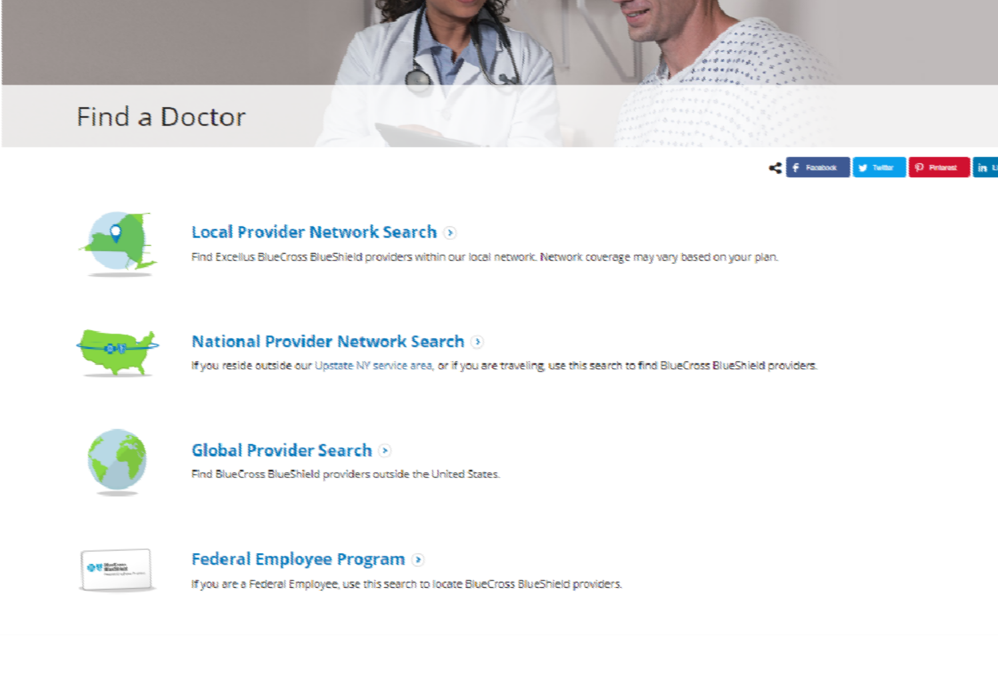


Welcome User's Name | Account Settings | Logout
Search
Get Help
Home My Account Claims Prescriptions Find a Doctor Health & Wellness Resources
Home
My Account
Claims
Prescriptions
Find a Doctor
Health & Wellness
Resources
Helpful Resources
Provider Manuals Policies
Prior Authorization Forms Print Forms
Clinical Resources Patient Education Tools
Get to Know Us
About Us News
Company Policies Careers
Join Our Network Quality Improvement
Let Us Help
Contact Us Glossary Staff Training
Give Us Feedback Fraud & Abuse
Access Provider Tools
View Eligibility & Benefits Check Claims
Clear Coverage Tool Update Practice Information Fee Schedules
Check Referrals
View the Excellus BCBS Service Area
Language Assistance and Non-Discrimination Notice
Español | 中文 | Pусский | Kreyòl Ayisyen | 한국어 | Italiano | שידיא | বাংলা | Polski | ﺔﻴﺑﺮﻌﻟا | Français | ودرا | Tagalog | ελληνικά | shqiptar
Copyright © 2017, Excellus BlueCross BlueShield, a nonprofit independent licensee of the Blue Cross Blue Shield Association. All rights reserved.
Follow us on
Terms of Use | Web Privacy Policy | Browser Support

Slide 8


Welcome User's Name | Account Settings | Logout
Search
Get Help
Home My Account Claims Prescriptions Find a Doctor Health & Wellness Resources
Home
My Account
Claims
Prescriptions
Find a Doctor
Health & Wellness
Resources
Search for a Doctor
Step 1: Select your plan
- Select -
Step 2: Narrow your search
Important information about Changes to this Directory.
Many of the health care providers in our network join quality programs. The organization does not use quality measures, member experience measures, or cost related measures to select any of our practitioners or hospitals for participation in the network, this includes those treating our Marketplace members.
Helpful Resources
Provider Manuals Policies
Prior Authorization Forms Print Forms
Clinical Resources Patient Education Tools
Get to Know Us
About Us News
Company Policies Careers
Join Our Network Quality Improvement
Let Us Help
Contact Us Glossary Staff Training
Give Us Feedback Fraud & Abuse
Access Provider Tools
View Eligibility & Benefits Check Claims
Clear Coverage Tool Update Practice Information Fee Schedules
Check Referrals
View the Excellus BCBS Service Area
Language Assistance and Non-Discrimination Notice
Español | 中文 | Pусский | Kreyòl Ayisyen | 한국어 | Italiano | שידיא | বাংলা | Polski | ﺔﻴﺑﺮﻌﻟا | Français | ودرا | Tagalog | ελληνικά | shqiptar
Copyright © 2017, Excellus BlueCross BlueShield, a nonprofit independent licensee of the Blue Cross Blue Shield Association. All rights reserved.
Follow us on
Terms of Use | Web Privacy Policy | Browser Support

Slide 9









Welcome User's Name | Account Settings | Logout
Search
Get Help
Home My Account Claims Prescriptions Find a Doctor Health & Wellness Resources
Home
My Account
Claims
Prescriptions
Find a Doctor
Health & Wellness
Resources
Search for a Doctor
Step 1: Select your plan
Health Plan Name
Step 2: Narrow your search
Location (optional)
Zip Code
- or -
Select County
Type of Doctor (optional)
Doctor Name (optional)
Select a Speciality
First Name
Last Name
Enter all or the first few letters
+ More Search Options
Search
Reset
Important information about Changes to this Directory.
Many of the health care providers in our network join quality programs. The organization does not use quality measures, member experience measures, or cost related measures to select any of our practitioners or hospitals for participation in the network, this includes those treating our Marketplace members.
Helpful Resources
Provider Manuals Policies
Prior Authorization Forms Print Forms
Clinical Resources Patient Education Tools
Get to Know Us
About Us News
Company Policies Careers
Join Our Network Quality Improvement
Let Us Help
Contact Us Glossary Staff Training
Give Us Feedback Fraud & Abuse
Access Provider Tools
View Eligibility & Benefits Check Claims
Clear Coverage Tool Update Practice Information Fee Schedules
Check Referrals
View the Excellus BCBS Service Area
Language Assistance and Non-Discrimination Notice
Español | 中文 | Pусский | Kreyòl Ayisyen | 한국어 | Italiano | שידיא | বাংলা | Polski | ﺔﻴﺑﺮﻌﻟا | Français | ودرا | Tagalog | ελληνικά | shqiptar
Copyright © 2017, Excellus BlueCross BlueShield, a nonprofit independent licensee of the Blue Cross Blue Shield Association. All rights reserved.
Follow us on
Terms of Use | Web Privacy Policy | Browser Support

